Slide 1
Chapter-10
Error Detection and Correction

Slide 2
Error
Data are transmitted in the network.
Data can be corrupted during transmission.
This is called transmission error.
For reliable communications, errors must be detected and corrected.

Slide 3
Types of Errors
Bit Error
Burst Error

Slide 4
How To Detect Errors?
Error detection means to decide whether the received data is correct or not without having a copy of the original message.
To detect or correct errors, we need to send extra (redundant) bits with data.
These extra bits are called redundant bits.

Slide 5
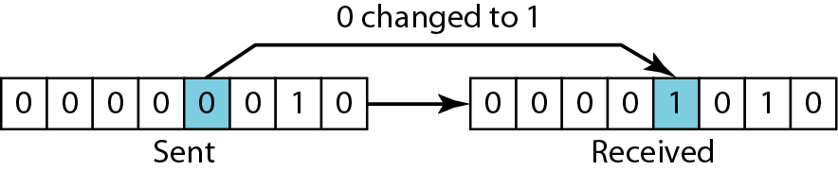
Bit Error
In a single-bit error, only 1 bit in the data unit has changed.

Slide 6
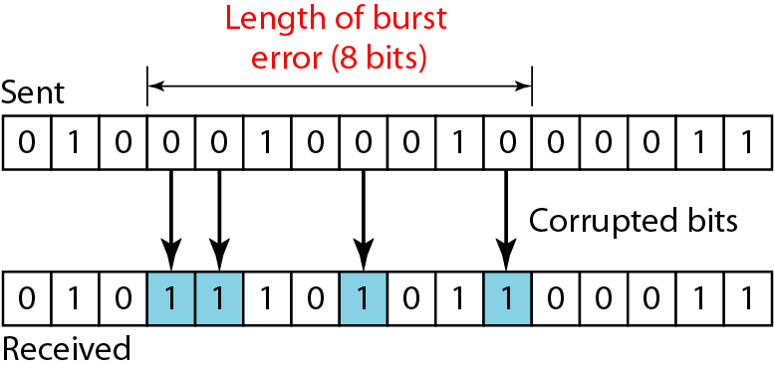
Burst Error
A burst error means that 2 or more bits in the data unit have changed.

Slide 7
Error Correction
It can be handled in two ways:
Forward error correction is the process in which the receiver tries to guess the message by using redundant bits.
Correction by retransmission is a technique in which the receiver detects the occurrence of an error and asks the sender to resend the message.

Slide 8
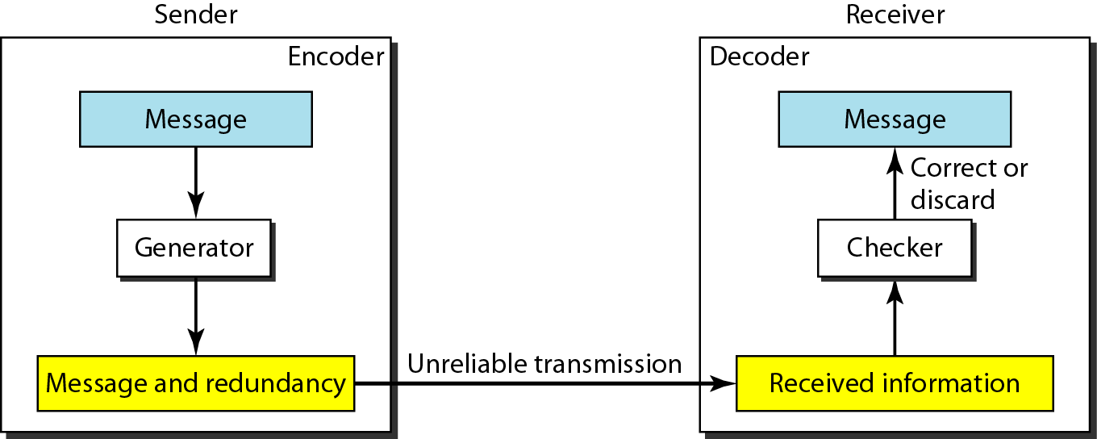
Coding
The sender adds redundant bits through a process that creates a relationship between the redundant bits and the actual data bits.
The receiver checks the relationships between the two sets of bits to detect or correct the errors.

Slide 9
Error Detection Techniques
There are four error detection techniques:
Vertical Redundancy Check (VRC)
Longitudinal Redundancy Check (LRC)
Checksum
Cyclic Redundancy Check(CRC)
Two Dimensional Parity Check

Slide 10
Vertical Redundancy Check (VRC)
It is also known as parity check.
Sender
1010010
Transmitted
Receiver
1 1010010
1 1010010
Even Parity Generator
1

Slide 11
Performance of VRC
It can detect single bit error.
It can detect burst error if the number or errors are odd.
Sender 1 10110🡪 Transmission error 1 11110🡪 Receiver rejects data
Sender 1 10110🡪 Transmission error 1 11100🡪 Receiver accepts data

Slide 12
Longitudinal Redundancy Check (LRC)
A block of bit is divided into rows and columns.
It is known as two dimensional parity check.
The parity bit is calculated for each column and sent along with the data.
The block of parity acts as the redundant bits.
11001 00110 11110 00010 00001 10100 11111
1 | 1 | 0 | 0 | 1
0 | 0 | 1 | 1 | 0
1 | 1 | 1 | 1 | 0
0 | 0 | 0 | 1 | 0
1 | 0 | 1 | 0 | 0
1 | 1 | 1 | 1 | 1
0 | 1 | 0 | 0 | 0
01000 | 11111 | 10100 | 00010 | 11110 | 00110 | 11001

Slide 13
Performance of LRC
If two bits of in one data units are damaged and two bits in exactly the same positions in another unit are also damaged, the LRC will not detect any error.
1 | 1 | 0 | 0 | 1
0 | 0 | 1 | 1 | 0
1 | 1🡪0 | 1 | 1 | 0
0 | 0🡪1 | 0 | 1 | 0
1 | 0 | 1 | 0 | 0
1 | 1 | 1 | 1 | 1
0 | 1 | 0 | 0 | 0

Slide 14
Checksum
Checksum 🡪 Check + Sum
Sender side 🡪 Checksum creation
Receiver side 🡪 Checksum validation

Slide 15
Checksum
Checksum Sender Side
Break the original message into ‘k’ number of blocks with ‘n’ bits in each block.
Sum all the ‘k’ data blocks.
Add the carry to the sum, if any.
Do 1’s complement to the sum 🡪 checksum

Slide 16
Checksum
Original Message: 10011001111000100010010010000100
10011001 | 11100010 | 00100100 | 10000100
 |  |  |  | 1 | 0 | 0 | 1 | 1 | 0 | 0 | 1
 |  |  |  | 1 | 1 | 1 | 0 | 0 | 0 | 1 | 0
 |  |  |  | 0 | 0 | 1 | 0 | 0 | 1 | 0 | 0
 |  |  |  | 1 | 0 | 0 | 0 | 0 | 1 | 0 | 0
Carry | 1 | 0 | Sum | 0 | 0 | 1 | 0 | 0 | 0 | 1 | 1
 |  |  |  |  |  |  |  |  |  | 1 | 0
Sum |  |  |  | 0 | 0 | 1 | 0 | 0 | 1 | 0 | 1
Checksum(1’s complement) |  |  |  | 1 | 1 | 0 | 1 | 1 | 0 | 1 | 0
Checksum | Original message
11011010 | 10011001 | 11100010 | 00100100 | 10000100
Transmitted Message:

Slide 17
Checksum
Checksum Receiver Side
Collect all the data blocks including the checksum.
Sum all the data blocks and the checksum.
If the result is all 1’s accept; else reject.

Slide 18
Checksum
Received Message
11011010 | 10011001 | 11100010 | 00100100 | 10000100
 |  |  |  | 1 | 0 | 0 | 1 | 1 | 0 | 0 | 1
 |  |  |  | 1 | 1 | 1 | 0 | 0 | 0 | 1 | 0
 |  |  |  | 0 | 0 | 1 | 0 | 0 | 1 | 0 | 0
 |  |  |  | 1 | 0 | 0 | 0 | 0 | 1 | 0 | 0
 |  |  |  | 1 | 1 | 0 | 1 | 1 | 0 | 1 | 0
Carry | 1 | 0 | Sum | 1 | 1 | 1 | 1 | 1 | 1 | 0 | 1
 |  |  |  |  |  |  |  |  |  | 1 | 0
Sum |  |  |  | 1 | 1 | 1 | 1 | 1 | 1 | 1 | 1

Slide 19
Performance of Checksum
It can check both the single bit and burst errors.
If one more bits of a segment are damaged and the corresponding bit or bits value in a second segment are also damaged, the sum of those columns will not change and the receiver will not detect the errors.

Slide 20
Cyclic Redundancy Check (CRC)
Steps of CRC operation at sender side:
Find the length of the divisor ‘L’.
Append ‘L-1’ bits (0’s) to the original message.
Perform binary division operation.
Remainder of the division = CRC.

Slide 21
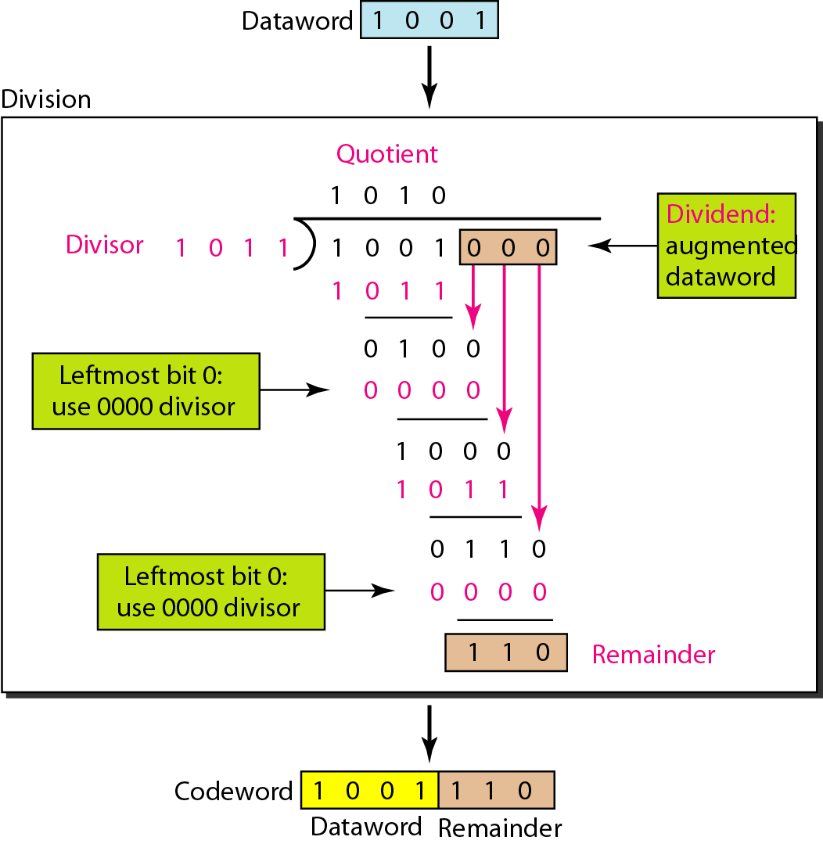
Cyclic Redundancy Check (CRC)

Slide 22
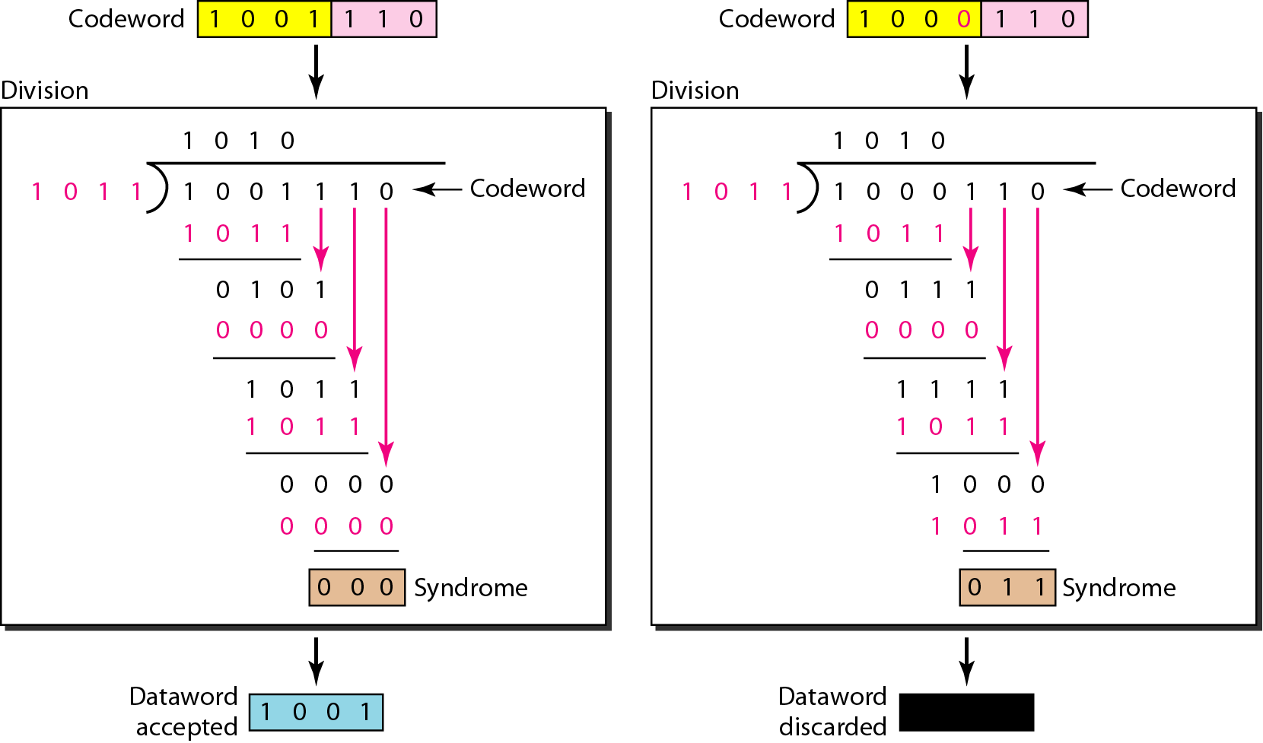
Cyclic Redundancy Check (CRC)

Slide 23
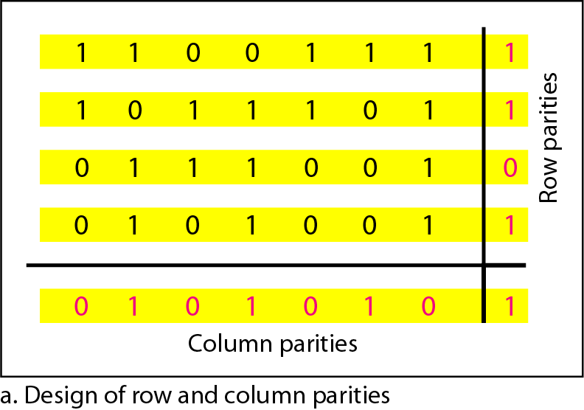
Two Dimensional Parity Check

Slide 24
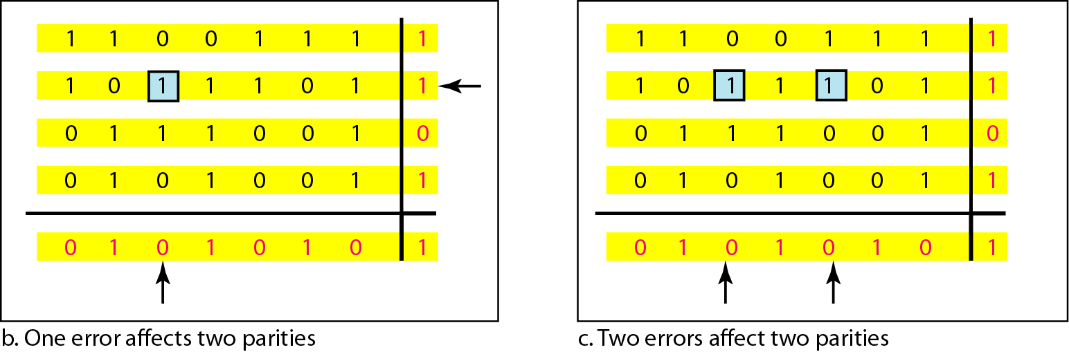
Two Dimensional Parity Check

Slide 25
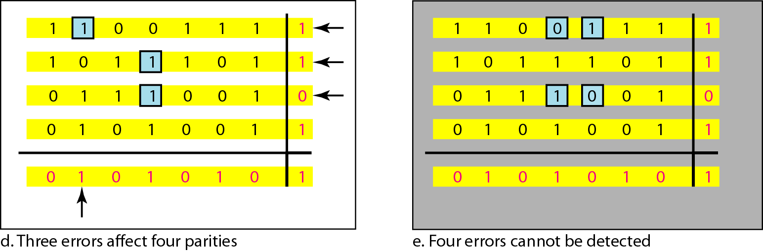
Two Dimensional Parity Check

